Slide 1
Chapter 02: Data Types
Variables/ Identifiers; Basic data types; Constants, Formatting and naming conventions; operators, expressions, Literals; Type conversions; Array
ILO: Develop simple applications for problem solving using a high-level programming language
Acknowledged: C++ for Everyone by C Horstmann by John Wiley & Sons.

Slide 2
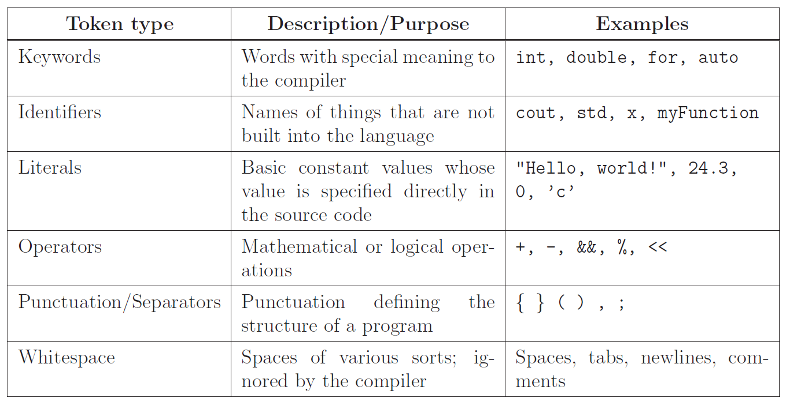
Tokens
Tokens are the minimal chunk of program that have meaning to the compiler –the smallest meaningful symbols in the language.

Slide 3
Variables
A variable
is used to store information:
can contain one piece of information at a time.
has an identifier:
The programmer picks a good name
A good name describes the contents of the variable or what the variable will be used for
When creating variables, the programmer specifies the type of information to be stored. A variable is often given an initial value.
the name of the variable

Slide 4
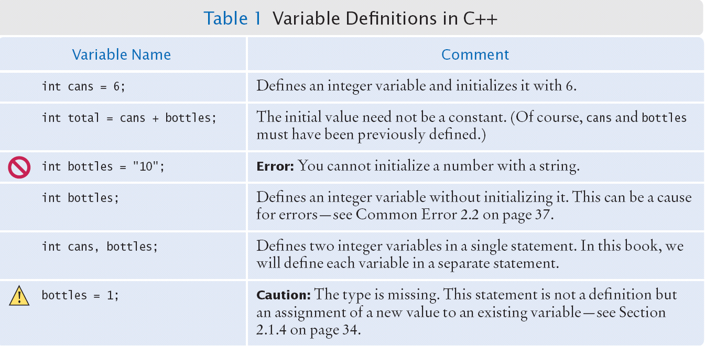
Variable Definitions

Slide 5
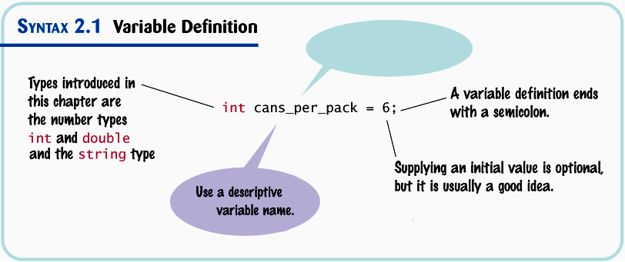
Variable Definitions
Must obey the rules for valid names

Slide 6
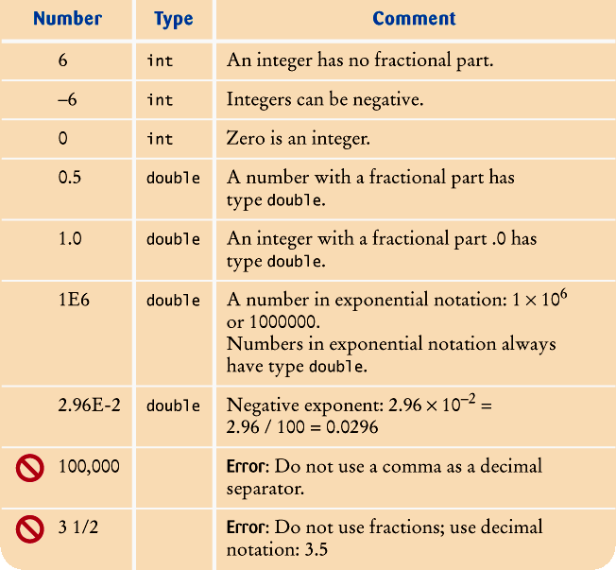
Number Types

Slide 7
Variable Names
Variable names must start with a letter or the underscore (_) character, and the remaining characters must be letters numbers, or underscores.
You cannot use other symbols such as $ or %. Spaces are not permitted inside names; you can use an underscore instead, as in can_volume.
Variable names are case-sensitive, that is, can_volume and can_Volume are different names. For that reason, it is a good idea to use only lowercase letters in variable names.
You cannot use reserved words such as double or return as names; these words are reserved exclusively for their special C++ meanings.

Slide 8
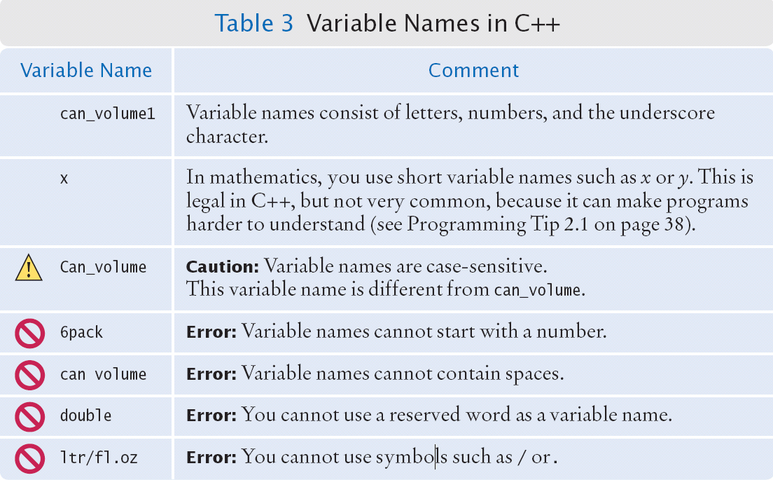
Variable Names

Slide 9
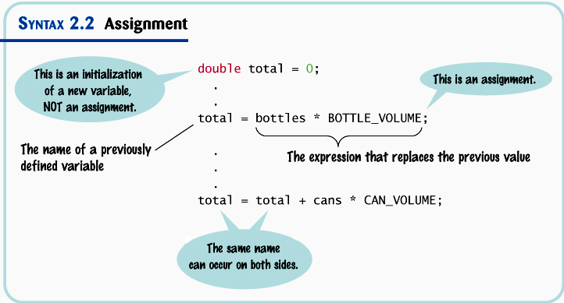
The Assignment Statement

Slide 10
The Assignment Statement
There is an important difference between a variable definition and an assignment statement:
int cans_per_pack = 6; // Variable definition
...
cans_per_pack = 8; // Assignment statement
The first statement is the definition of cans_per_pack.
The second statement is an assignment statement. An existing variable’s contents are replaced.

Slide 11
The Assignment Statement
counter = 11; // set counter to 11 counter = counter + 1
Look up what is currently in counter (11)
Add 1 to that value (12)
copy the result of the addition expression into the variable on the left, changing counter
cout << counter << endl;
12 is shown

Slide 12
Constants
Sometimes the programmer knows certain values just from analyzing the problem, for this kind of information, programmers use the reserved word const.
The reserved word const is used to define a constant.
A const is a variable whose contents cannot be changed and must be set when created. (Most programmers just call them constants, not variables.)
Constants are commonly written using capital letters to distinguish them visually from regular variables:
const double BOTTLE_VOLUME = 2;

Slide 13
Constants
Using #define preprocessor.
#include <iostream>
using namespace std;
#define LENGTH 10
#define WIDTH 5
#define NEWLINE '\n'
int main() {
int area;
area = LENGTH * WIDTH;
cout << area;
cout << NEWLINE;
return 0;
}

Slide 14
Comments
Comments are explanations for human readers of your code (other programmers).
The compiler ignores comments completely.
double can_volume = 0.355; // Liters in a 12-ounce can
Comment

Slide 15
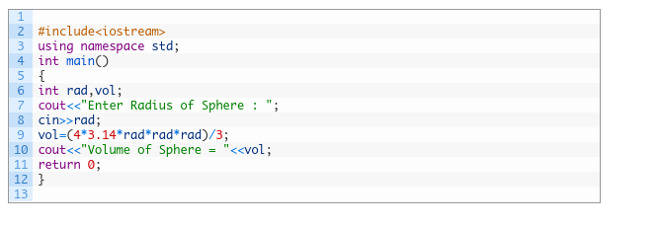

Slide 16
Common Error – Using Undefined Variables
You must define a variable before you use it for the first time.
For example, the following sequence of statements would not
be legal:
double can_volume = 12 * liter_per_ounce;
double liter_per_ounce = 0.0296;
Statements are compiled in top to bottom order. When the compiler reaches the first statement, it does not know that liter_per_ounce will be defined in the next line, and it reports an error.

Slide 17
Comments
Comments can be written in two styles:
Single line:
double can_volume = 0.355; // Liters in a 12-ounce can
The compiler ignores everything after // to the end of line
Multiline for longer comments:
/* This program computes the volume (in liters) of a six-pack of soda cans. */

Slide 18
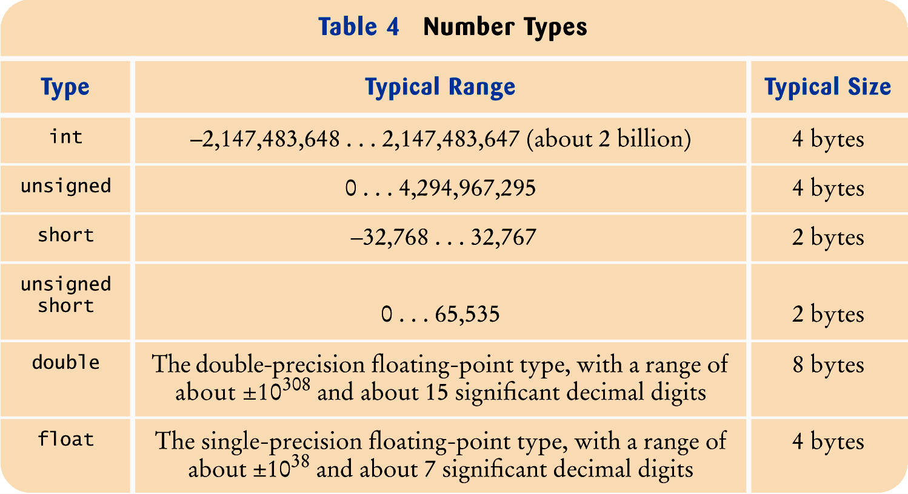
Numeric Types in C++

Slide 19
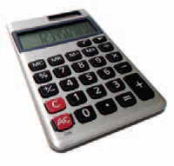
Arithmetic Operators
C++ has the same arithmetic operators as a calculator:
* for multiplication: a * b (not a . b or ab as in math)
/ for division: a / b (not ÷ or a fraction bar as in math)
+ for addition: a + b
- for subtraction: a – b

Slide 20
Increment and Decrement
Changing a variable by adding or subtracting 1 is so common that there is a special shorthand for these:
The increment and decrement operators.
counter++; // add 1 to counter
counter--; // subtract 1 from counter

Slide 21
Integer Division and Remainder
The % operator computes the remainder of an integer division.
It is called the modulus operator (also modulo and mod)
It has nothing to do with the % key on a calculator

Slide 22
Powers and Roots
In C++, there are no symbols for powers and roots. To compute them, you must call functions.
The C++ library defines many mathematical functions such as sqrt (square root) and pow (raising to a power).
To use the functions in this library, called the cmath library, you must place the line: #include <cmath> at the top of your program file.
It is also necessary to include using namespace std; at the top of your program file.

Slide 23
Powers and Roots
The power function has the base followed by a comma
followed by the power to raise the base to:
pow(base, exponent)
Using the pow function:
b + pow(1 + r / 100, n)

Slide 24
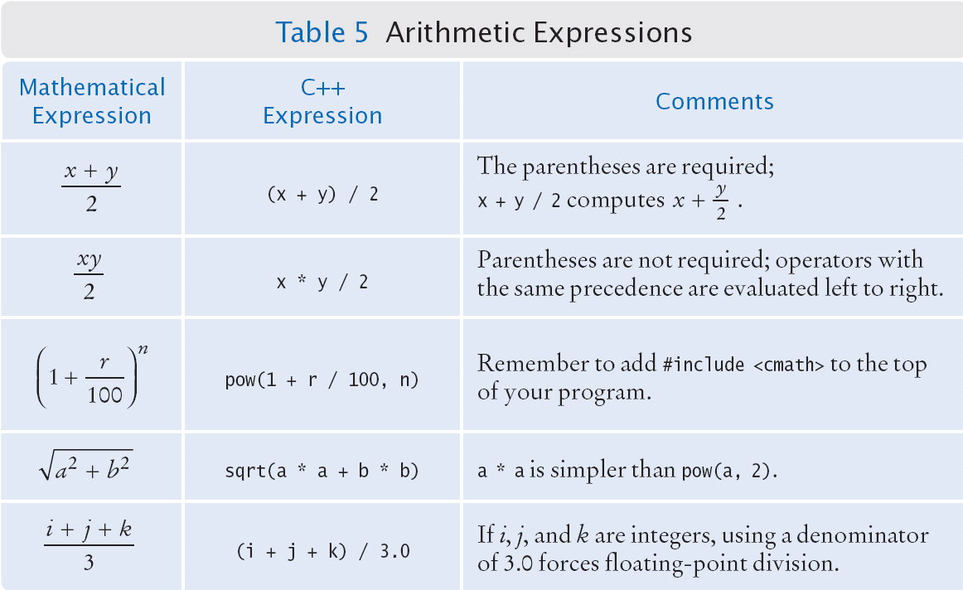
Powers and Roots

Slide 25
Common Error – Forgetting Header Files
Every program that carries out input or output needs the <iostream> header.
If you use mathematical functions such as sqrt, you need to include <cmath>.
If you forget to include the appropriate header file, the compiler will not know symbols such as
cout or sqrt.
If the compiler complains about an undefined function or symbol, check your header files.

Slide 26
Casts
For example, if you store a double value into
an int variable, information is lost in two ways:
The fractional part will be lost.
int n = 1.99999; // NO
1 is stored
(the decimal part is truncated)
The magnitude may be too large.
int n = 1.0E100; // NO
is not likely to work, because 10 to the100th power is larger than the largest representable integer.

Slide 27
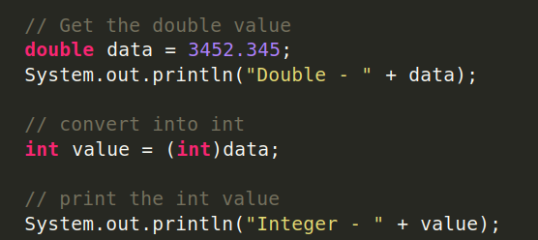
Casts
A cast is a conversion from one type
(such as double)
to another type (such as int).

Slide 28
Input
Sometimes the programmer does not know what should be stored in a variable – but the user does.
The programmer must get the input value from the user
Users need to be prompted (how else would they know they need to type something?)
Prompts are done in output statements
The keyboard needs to be read from
This is done with an input statement

Slide 29
Input
The input statement
To read values from the keyboard, you input them from an object called cin.
The << operator denotes the “send to” command.
cin >> bottles; is an input statement. Of course, bottles must be defined earlier.

Slide 30
Input
You can read more than one value in a single input statement:
cout << "Enter the number of bottles and cans: ";
cin >> bottles >> cans;
The user can supply both inputs on the same line:
Enter the number of bottles and cans: 2 6

Slide 31
Input
You can read more than one value in a single input statement:
cout << "Enter the number of bottles and cans: ";
cin >> bottles >> cans;
Alternatively, the user can press the Enter key after each input:
Enter the number of bottles and cans: 2
6

Slide 32
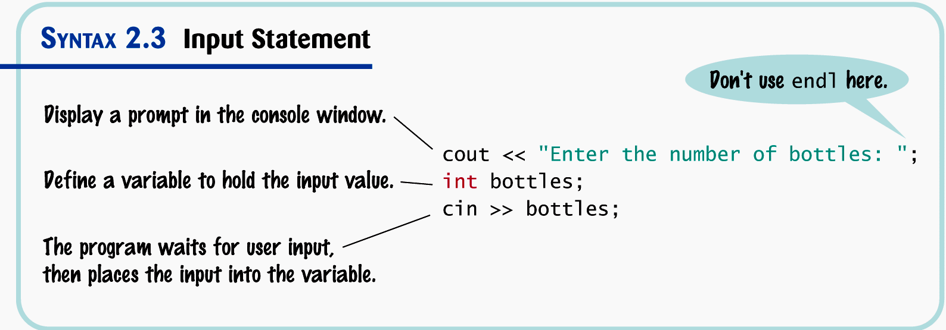
Input Statement

Slide 33
string
int
char
float
bool

Slide 34
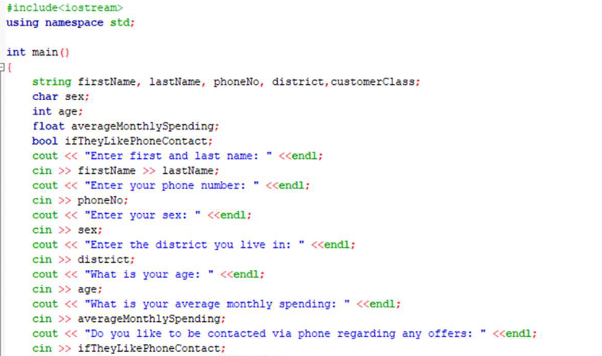

Slide 35
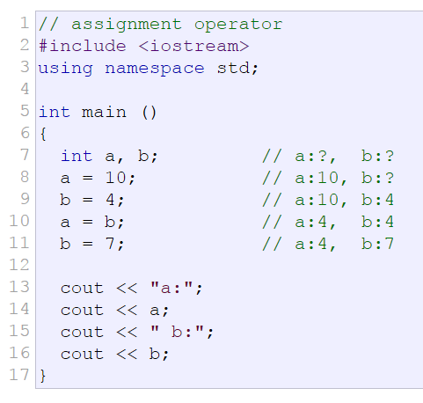

Slide 36
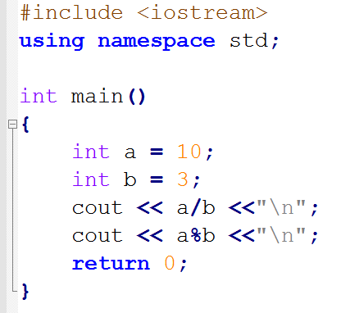
Output
3
1

Slide 37
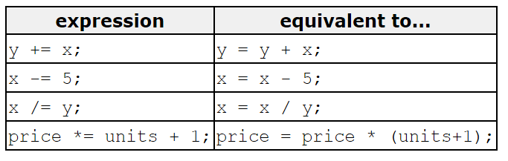
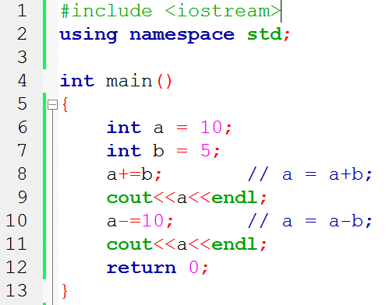

Slide 38
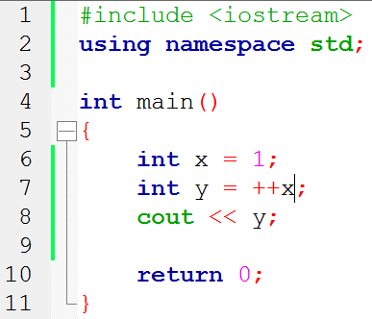
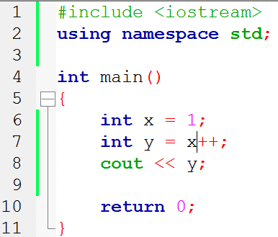
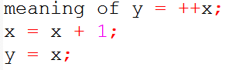
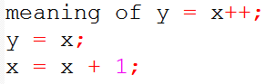
Increment and decrement: ++x vs x++
Write down the outputs of the following programs.

Slide 39
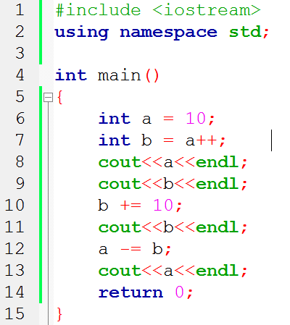
Exercise
Write down the output of the following code.

Slide 40
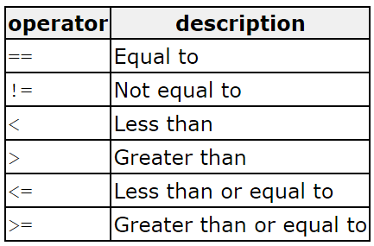
Relational and comparison operators ( ==, !=, >, <, >=, <= )
Two expressions can be compared using relational and equality operators. E.g., to know if two values are equal or if one is greater than the other.
The result of such an operation is either true or false.

Slide 41
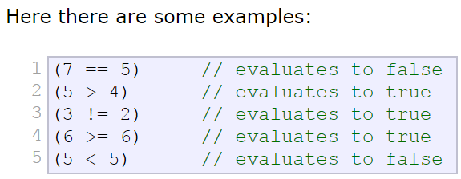
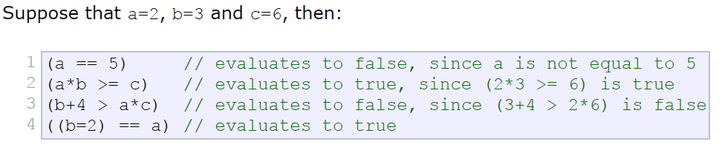
Relational and comparison operators ( ==, !=, >, <, >=, <= )
Be careful! The assignment operator (operator =, with one equal sign) is not the same as the equality comparison operator (operator ==, with two equal signs)

Slide 42
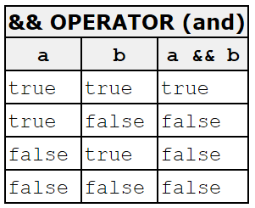
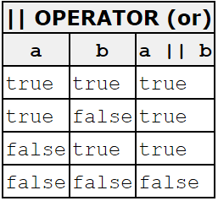
Logical operators ( !, &&, || )
The logical operators && and || are used when evaluating two expressions to obtain a single relational result.
The operator && corresponds to the Boolean logical operation AND, which yields true if both of its operands are true, and false otherwise.

Slide 43
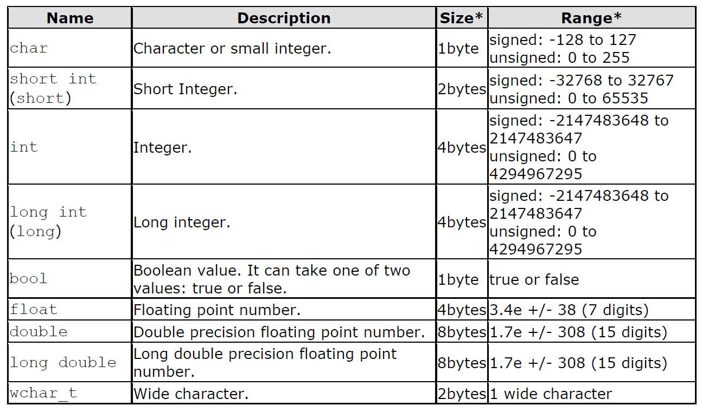
Data Types

Slide 44
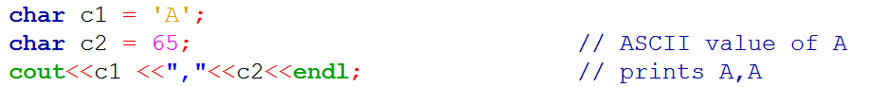
Char data type
char data type is used to store 8-bit ASCII (American Standard Code for Information Interchange) characters
Characters are given inside single quotes.
Each character is associated with an unsigned integer number.

Slide 45
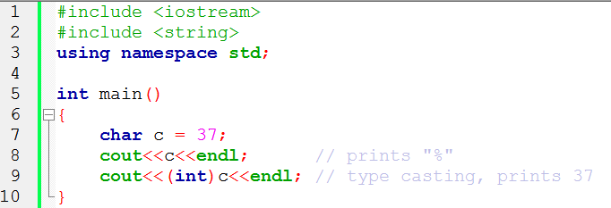

Slide 46
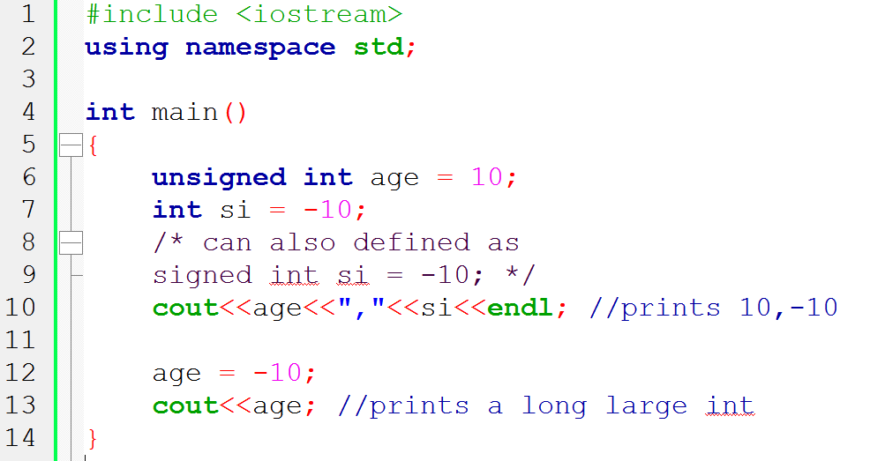

Slide 47
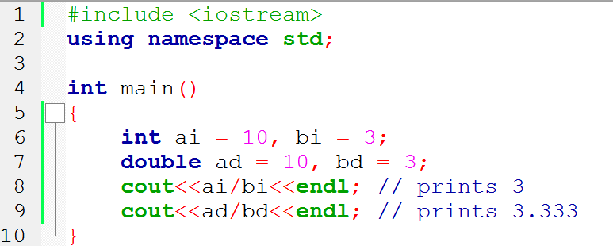

Slide 48
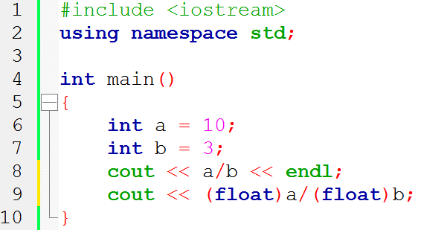
Type conversion/casting
Write down the output of the following code:

Slide 49
Strings
Strings are sequences of characters: "Hello world"
If you include the string header, you can create variables to hold literal strings:
#include <string>
using namespace std;
...
string name = "Harry"; // literal string "Harry" stored

Slide 50
Strings
String variables are guaranteed to be initialized even if you don’t initialize them:
string response; // literal string "" stored
"" is called the empty or null string.

Slide 51
Concatenation
Use the + operator to concatenate strings; that is, put them together to yield a longer string.
string fname = "Harry";
string lname = "Morgan";
string name = fname + lname;
cout << name << endl;
name = fname + " " + lname;
cout << name << endl;
The output will be
HarryMorgan
Harry Morgan

Slide 52
Common Error – Concatenation of literal strings
string greeting = "Hello, " + " World!";
// will not compile
Literal strings cannot be concatenated.

Slide 53
String Input
You can read a string from the console:
cout << "Please enter your name: "; string name; cin >> name;
When a string is read with the >> operator, only one word is placed into the string variable. For example, suppose the user types
Harry Morgan
as the response to the prompt. This input consists of two words. Only the string "Harry" is placed into the variable name.

